Slide 1

By Felix And Tommy

Slide 2
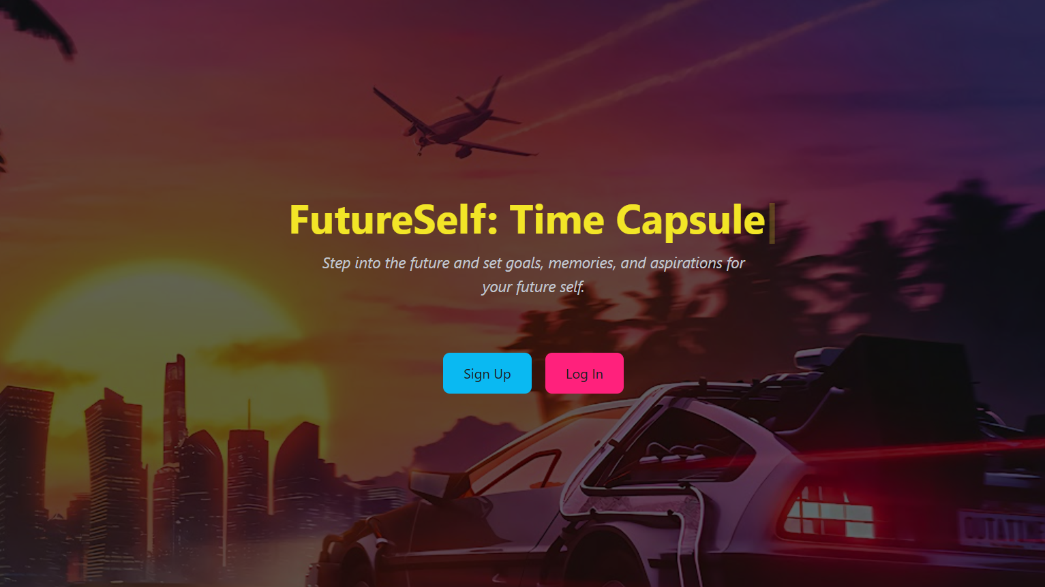
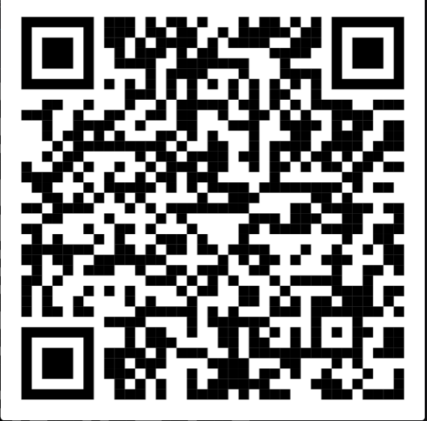
QR Code To The Website
Demo Website

Slide 3
Project
We’ve created a unique application that stores your goals and letters with two special features:
Long-Term Reminders Unlike typical reminders, which focus on short-term tasks like a day or week ahead, our app allows you to set reminders for 5 or even 10 years into the future. These reminders encourage you to reflect on your goals and messages from your past self, promoting long-term growth and introspection.
AI-Powered Enhancement Our app also features an AI component that can refine and enhance your messages. It can improve your text and even suggest additional bullet points to make your content more impactful and polished.

Slide 4
Impact and Learned
Problem & Solution: This app solves two key issues:
Long-Term Goal Reflection: Most reminders are short-term. Our app offers 5- to 10-year reminders, encouraging users to reconnect with past goals and reflect on personal growth.
Clear Goal Articulation: With an AI component, the app refines user messages and provides actionable suggestions, making goals more practical and inspiring.
Impact & Wow Factor:
Goal + AI Enhancement: This unique combination helps users set clear, actionable goals for long-term success.
Practicality & Innovation:
Real-World Application: The app serves as a digital journal for goal tracking and self-reflection, suitable for personal and professional growth.
Learning & Innovation: This project introduced a new approach to goal tracking by integrating AI and long-term scheduling, adding valuable skills in AI and development.

